Slide 1


PFA Housing project
By:
Md Hafizur Rahman

Slide 2
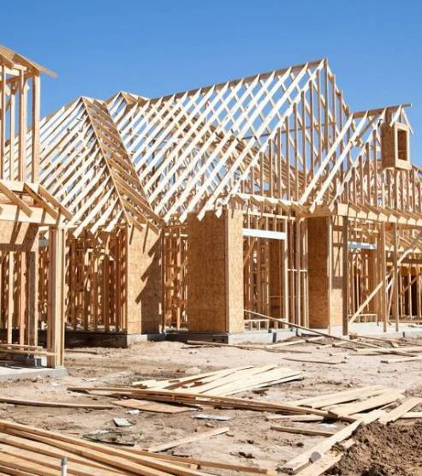

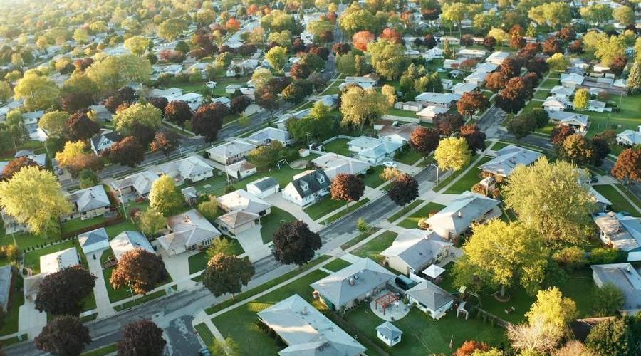
Agenda
Acknowledgement.
Problem Definition.
Data Analysis.
EDA Concluding Remark.
Pre-Processing Remark.
Building Machine Learning Models.
Concluding Remarks.

Slide 3


Acknowledgement:
I express my sincere gratitude to Flip Robo Technologies for giving me the opportunity to work on this project “Housing Price prediction” using ML Technique & Algorithms. I would also like to thank DataTrained Institute for teaching me the required skills and knowledge which helped me to process the Data-Set. I acknowledge my indebtedness to the authors of papers titled: “House Price Prediction using a Machine Learning Model: A Survey of Literature” and “The impact of housing quality on house prices in eight capital cities, Australia” for providing me with invaluable insights and knowledge of the dynamic relationships that exist in the economics of real estate and housing markets.

Slide 4
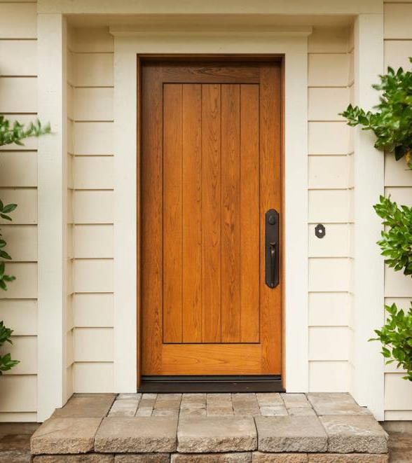
Problem Definition

Slide 5
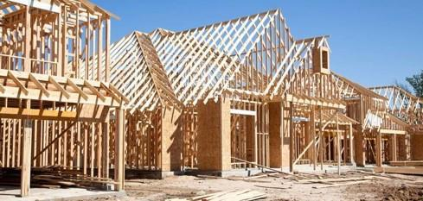


Statement:
Houses are one of the necessary need of each and every person around the globe and therefore housing and real estate market is one of the markets which is one of the major contributors in the world’s economy. It is a very large market and there are various companies working in the domain. Data science comes as a very important tool to solve problems in the domain to help the companies increase their overall revenue, profits, improving their marketing strategies and focusing on changing trends in house sales and purchases. Predictive modelling, Market mix modelling, recommendation systems are some of the machine learning techniques used for achieving the business goals for housing companies. Our problem is related to one such housing company. A US-based housing company named Surprise Housing has decided to enter the Australian market. The company uses data analytics to purchase houses at a price below their actual values and flip them at a higher price. For the same purpose, the company has collected a data set from the sale of houses in Australia. The data is provided in the CSV file below. The company is looking at prospective properties to buy houses to enter the market. You are required to build a model using Machine Learning in order to predict the actual value of the prospective properties and decide whether to invest in them or not.
For this company wants to know:
• Which variables are important to predict the price of variable?
• How do these variables describe the price of the house?

Slide 6
Business Goal:
You are required to model the price of houses with the available independent variables. This model will then be used by the management to understand how exactly the prices vary with the variables. They can accordingly manipulate the strategy of the firm and concentrate on areas that will yield high returns. Further, the model will be a good way for the management to understand the pricing dynamics of a new market.

Slide 7
Technical Requirements:
• Data contains 1460 entries each having 81 variables.
• Data contains Null values. You need to treat them using the domain knowledge and your own understanding.
• Extensive EDA has to be performed to gain relationships of important variable and price.
• Data contains numerical as well as categorical variable. You need to handle them accordingly.
• You have to build Machine Learning models, apply regularization and determine the optimal values of Hyper Parameters.
• You need to find important features which affect the price positively or negatively.
• Two datasets are being provided to you (test.csv, train.csv).

Slide 8
DATA ANALYSIS

Slide 9

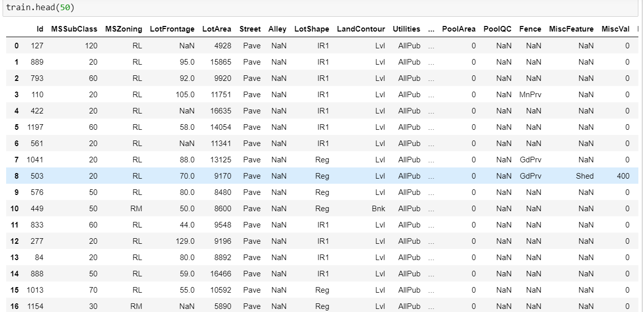
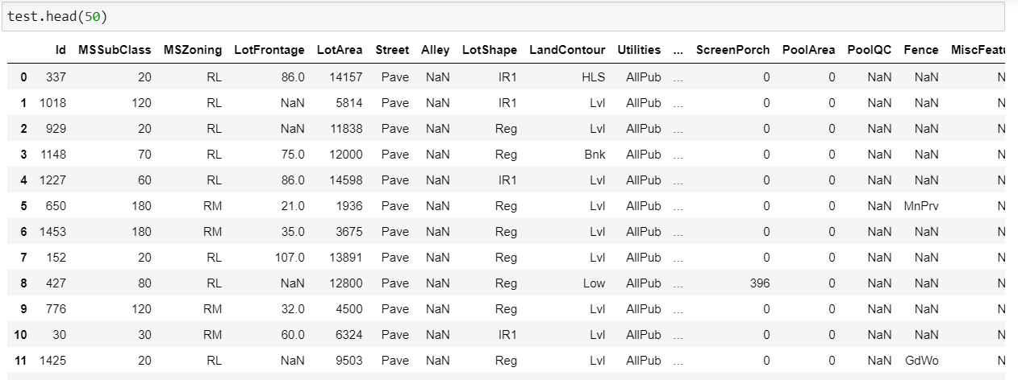
Datasets
We have two data set given for the prediction analysis. We use the ‘train.csv’ to train our program to predict the best model and use test.csv file to compare the prediction with our trained model

Slide 10
DATA-SET Description
MSSubClass: Identifies the type of dwelling involved in the sale.
MSZoning: Identifies the general zoning classification of the sale.
LotFrontage: Linear feet of street connected to property
LotArea: Lot size in square feet
Street: Type of road access to property
Alley: Type of alley access to property
LotShape: General shape of property
LandContour: Flatness of the property
Utilities: Type of utilities available
LotConfig: Lot configuration
LandSlope: Slope of property
Neighborhood: Physical locations within Ames city limits
Condition1: Proximity to various conditions
Condition2: Proximity to various conditions (if more than one is present)
BldgType: Type of dwelling
HouseStyle: Style of dwelling
OverallQual: Rates the overall material and finish of the house
OverallCond: Rates the overall condition of the house
YearBuilt: Original construction date
YearRemodAdd: Remodel date (same as construction date if no remodeling or additions)
RoofStyle: Type of roof
RoofMatl: Roof material
Exterior1st: Exterior covering on house
Exterior2nd: Exterior covering on house (if more than one material)
MasVnrType: Masonry veneer type
MasVnrArea: Masonry veneer area in square feet

Slide 11
ExterQual: Evaluates the quality of the material on the exterior
ExterCond: Evaluates the present condition of the material on the exterior
Foundation: Type of foundation
BsmtQual: Evaluates the height of the basement
BsmtCond: Evaluates the general condition of the basement
BsmtExposure: Refers to walkout or garden level walls
BsmtFinType1: Rating of basement finished area
BsmtFinSF1: Type 1 finished square feet
BsmtFinType2: Rating of basement finished area (if multiple types)
BsmtFinSF2: Type 2 finished square feet
BsmtUnfSF: Unfinished square feet of basement area
TotalBsmtSF: Total square feet of basement area
Heating: Type of heating
HeatingQC: Heating quality and condition
CentralAir: Central air conditioning
Electrical: Electrical system
1stFlrSF: First Floor square feet
2ndFlrSF: Second floor square feet
LowQualFinSF: Low quality finished square feet (all floors)
GrLivArea: Above grade (ground) living area square feet
BsmtFullBath: Basement full bathrooms
BsmtHalfBath: Basement half bathrooms
FullBath: Full bathrooms above grade
HalfBath: Half baths above grade
Bedroom: Bedrooms above grade (does NOT include basement bedrooms)
Kitchen: Kitchens above grade
KitchenQual: Kitchen quality
TotRmsAbvGrd: Total rooms above grade (does not include bathrooms)
Functional: Home functionality (Assume typical unless deductions are warranted)
Fireplaces: Number of fireplaces
FireplaceQu: Fireplace quality

Slide 12
GarageType: Garage location
GarageYrBlt: Year garage was built
GarageFinish: Interior finish of the garage
GarageCars: Size of garage in car capacity
GarageArea: Size of garage in square feet
GarageQual: Garage quality
GarageCond: Garage condition
PavedDrive: Paved driveway
WoodDeckSF: Wood deck area in square feet
OpenPorchSF: Open porch area in square feet
EnclosedPorch: Enclosed porch area in square feet
3SsnPorch: Three season porch area in square feet
ScreenPorch: Screen porch area in square feet
PoolArea: Pool area in square feet
PoolQC: Pool quality
Fence: Fence quality
MiscFeature: Miscellaneous feature not covered in other categories
MiscVal: $Value of miscellaneous feature
MoSold: Month Sold (MM)
YrSold: Year Sold (YYYY)
SaleType: Type of sale
SaleCondition: Condition of sale
Target Column:
SalePrice

Slide 13
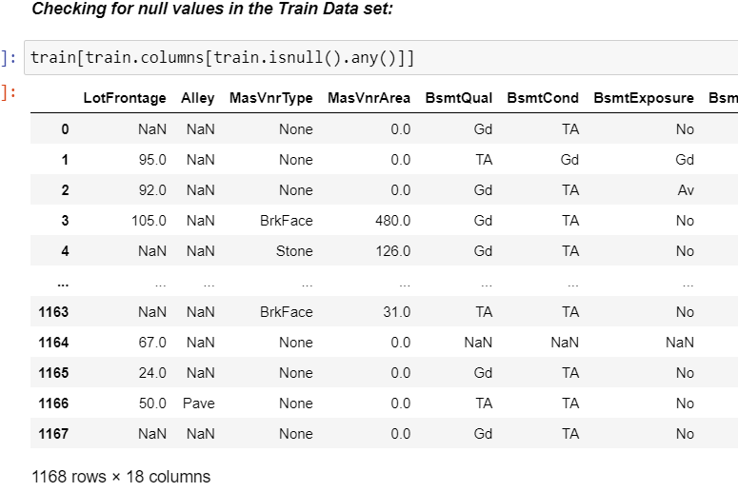
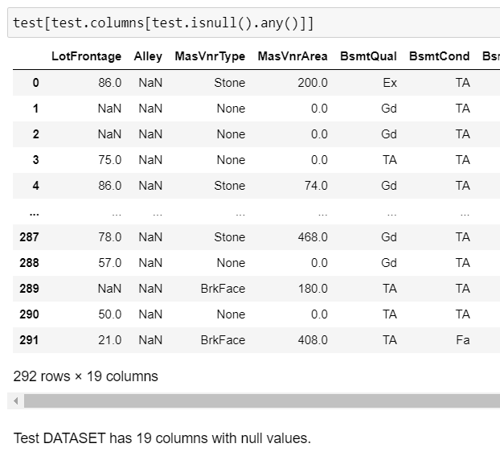
Analytical Problem Framing
Data Preprocessing:
Checking for null values
It’s observed that there are 18 columns in train data frame with null values and 19 columns in test data frame with null values.

Slide 14

Analytical Problem Framing
KNN imputation technique was used to impute values to missing data in LotFrontage, while the missing values in the rest of the columns were imputed with the most frequently occurring values of their respective columns.
Data Inputs- Logic- Output Relationships
The Datasets consist mainly of object data type variables and a few float and int data type variables. The relationships between the independent variables and dependent variable were analysed
Features like Lot area, Lot Frontage, Overall Quality, Overall Condition, Basement Finishing, Total Basement Surface Area, first and 2nd Floor square feet, Garage capacity,Total rooms have a positive linear relationship, therefore increase in their values leads to increase in SalePrice. Whereas Age of Housem Remodellling age Garrage age have a linear negative relationship and therefore increase in their values leads to a decrease in SalePrice.

Slide 15
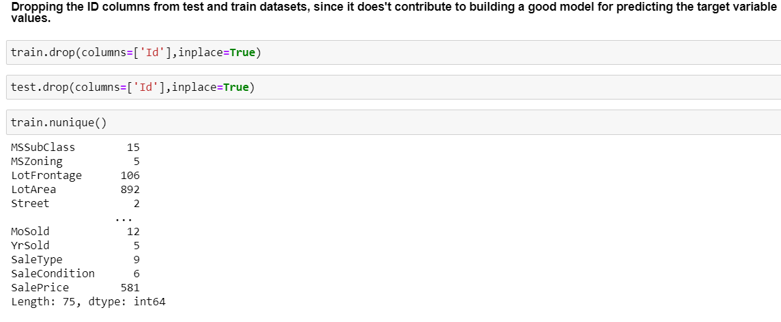
Columns which are irrelevant to the models were droped.

Slide 16
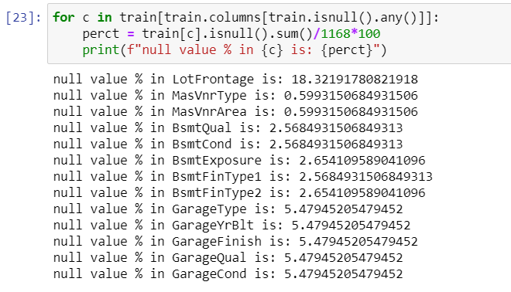
Finding the null value percentage in each of the columns in test dataset.

Slide 17
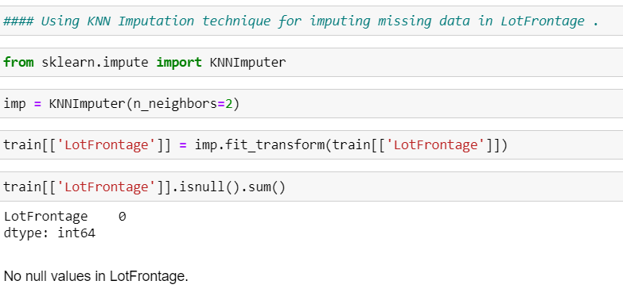
Taking care of missing values in remaining columns

Slide 18
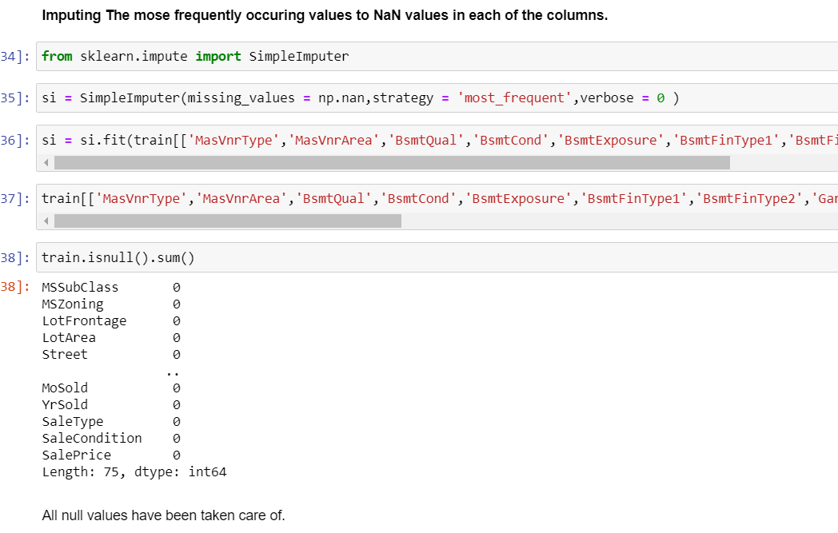

Slide 19
Exploratory Data Analysis

Slide 20
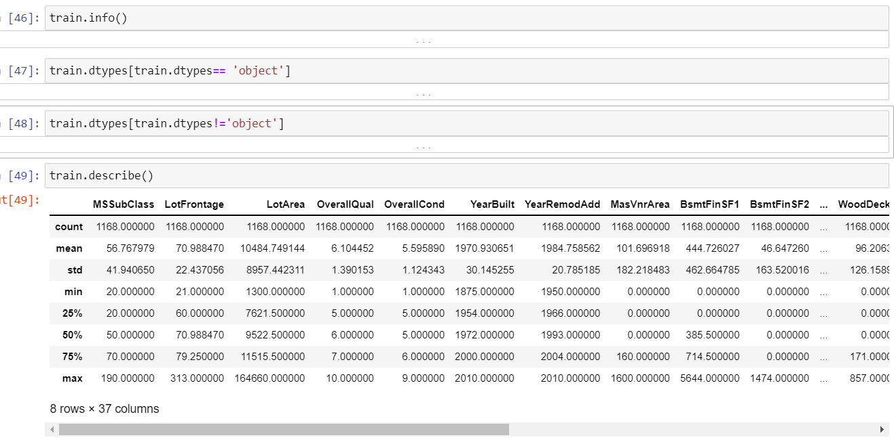
Performing Basic EDA Process

Slide 21
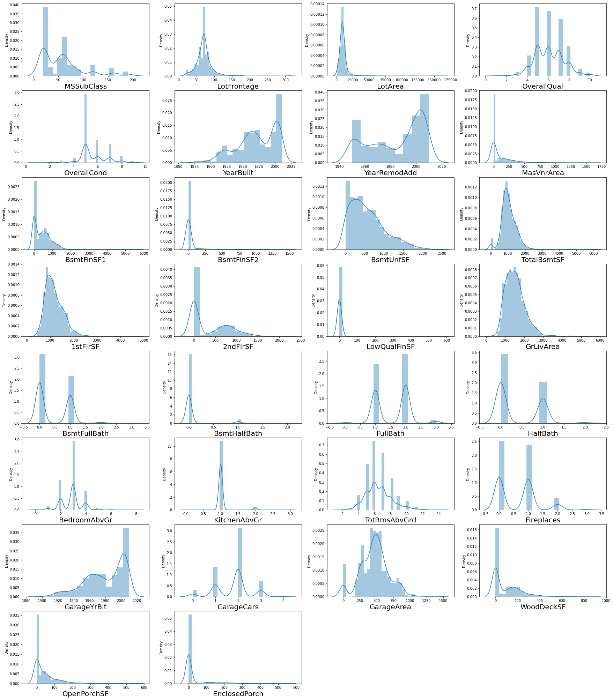
Plotting and analysing feature columns
Notes:
plt.figure(figsize=(30,45),facecolor='white')
plotnum=1
for col in train[train.columns[train.dtypes != 'object']]:
if plotnum<=30:
plt.subplot(10,4,plotnum)
sea.distplot(train[col])
plt.xlabel(col,fontsize=20)
plotnum+=1
plt.show()

Slide 22
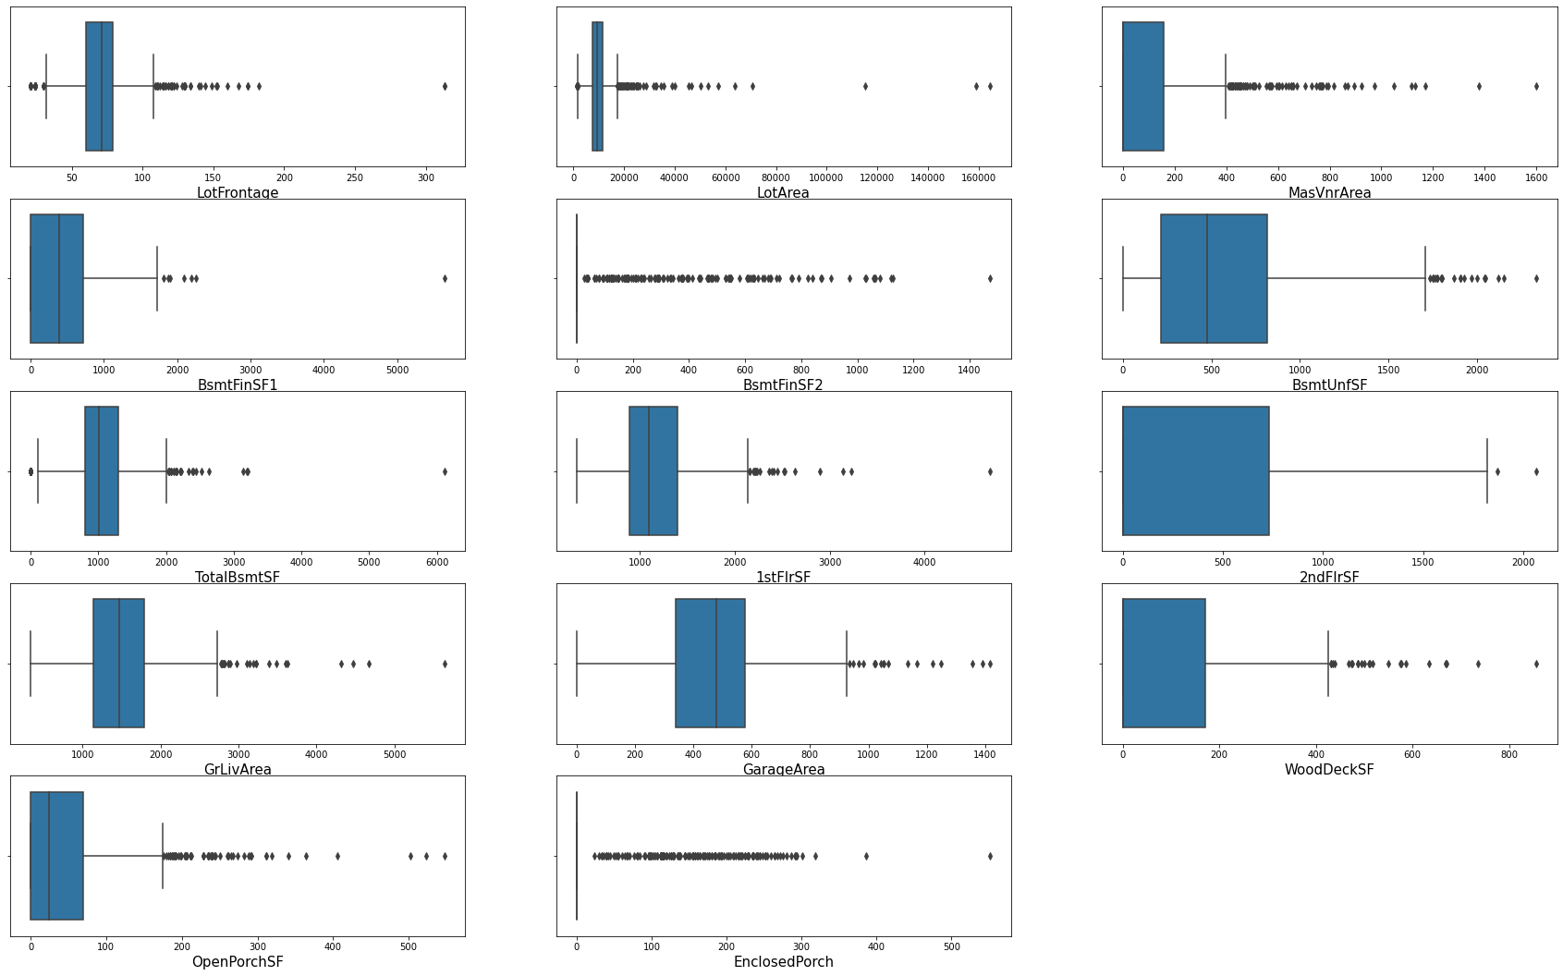
Outliers check
Notes:
plt.figure(figsize=(30,30),facecolor='white')
plotnum=1
for col in train[['LotFrontage','LotArea','MasVnrArea','BsmtFinSF1','BsmtFinSF2','BsmtUnfSF','TotalBsmtSF','1stFlrSF','2ndFlrSF','GrLivArea','GarageArea','WoodDeckSF','OpenPorchSF','EnclosedPorch']]:
if plotnum<=20:
plt.subplot(8,3,plotnum)
sea.boxplot(train[col])
plt.xlabel(col,fontsize=15)
plotnum+=1
plt.show()

Slide 23
Skewness Check was performed
Notes:
plt.figure(figsize=(10,300),facecolor='white')
plotnum=1
for col in train[train.columns[train.dtypes == 'object']]:
if plotnum<=40:
plt.subplot(40,1,plotnum)
sea.countplot(train[col])
plt.xlabel(col,fontsize=15)
plotnum+=1
plt.show()

Slide 24
Residential Low Density is the most common zoing classification
Most common Street Type is 'Pave'
Regular is the most common LotShape, followed by Slightly irregular
Most Properties have Near Flat/Level LandContour
All public Utilities are available
Inside lot is the most common Lot configuration
Slope of property land is most commonly gentle
Most Housing properties are situated in Neighborhoods of North Ames, followed by College Creek,Edwards and Old Town

Slide 25
Most Housing properties are in proximity to Normal conditions
Most Housing properties are of Single-family Detached type
Most Housing properties 1 storied and 2 storied
Most Houses have Gable roof style
Most Houses have roofs made of Standard (Composite) Shingle
Vinyl Siding is the most common exterior covering used
Most Houses don't have a Masonry veneer type while some have Brick Face
The quality of the material on the exterior is most commonly average/typical

Slide 26
The present condition of the material on the exterior is most commonly average/typical
Two of the most common foundation types are Cinder Block and Poured Contrete
The height of the basement is usually either Typical (80-89 inches) or Good (90-99 inches)
The general condition of the basement is commonly Typical with slight dampness
Basements most commonly have no exposure
Most houses have Basements that are usually unfinished followed by houses with basements having Good Living Quarters
Most houses have Gas forced warm air furnace heating arrangement

Slide 27
Most houses have Excellent Heating quality and condition
Most houses have Central air conditioning
Most houses have Standard Circuit Breakers & Romex Electrical system
Most houses have Most houses have Typical/Average and Good Kitchen quality
Most houses have Typical Functionality

Slide 28
Most houses have a Garage Attached to home
Most houses have an Unfinished garage
Garage is usually Typical/Average
Garage condition is usually Typical/Average
Most houses have a Paved driveway
Warranty Deed - Conventional is the most common Type of sale
Condition of sale is most commonly a Normal Sale

Slide 29
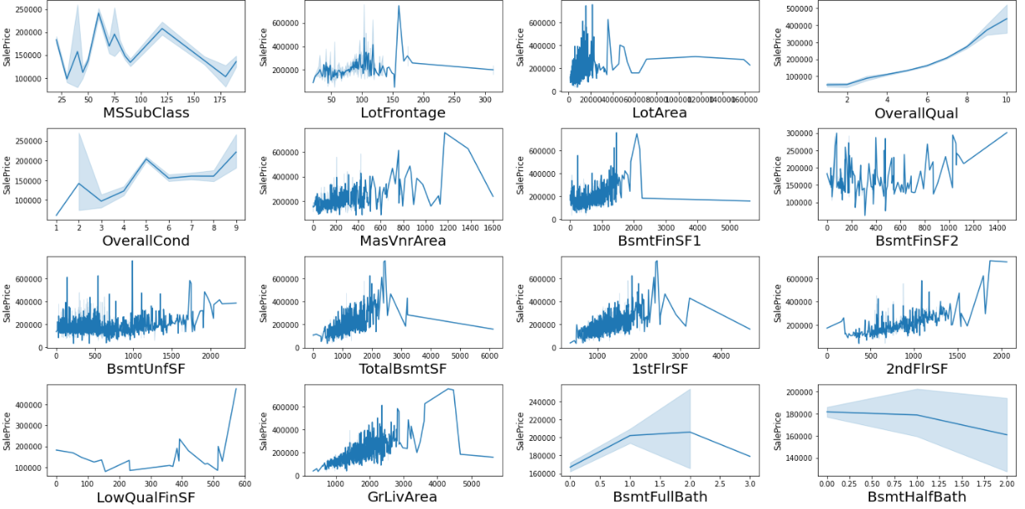
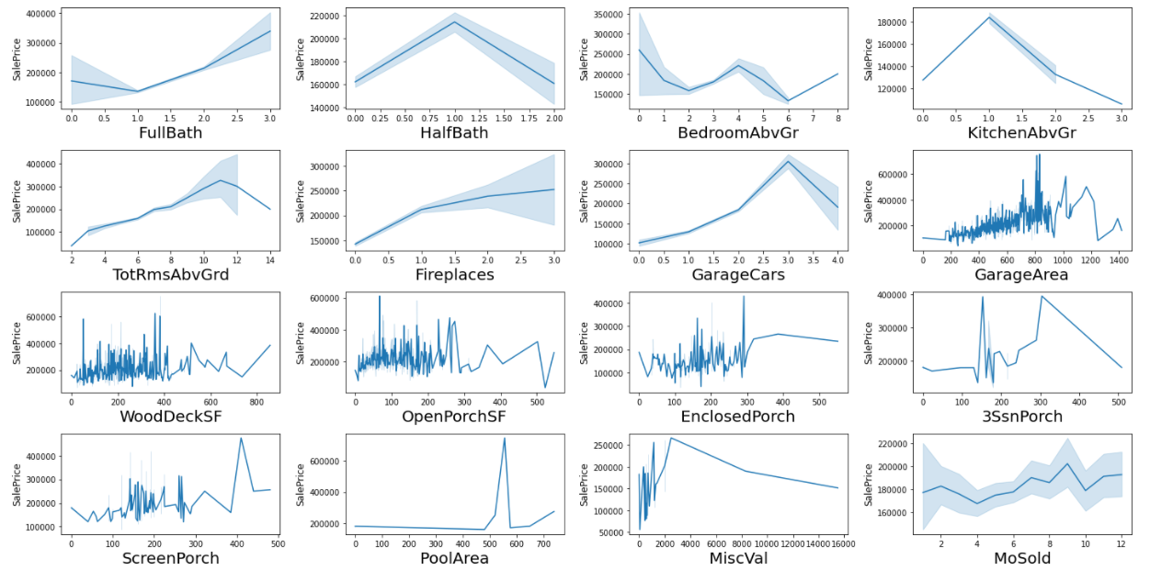
Graph were plotted to check how each column affect the Sale Price

Slide 30
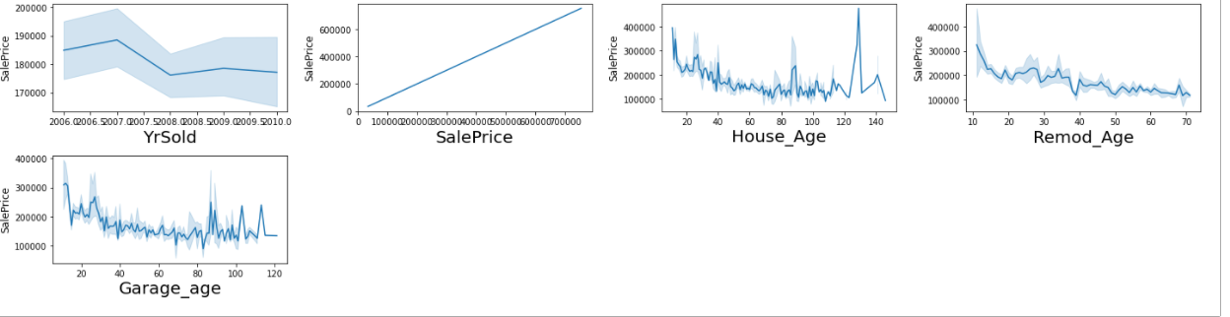
Notes:
plt.figure(figsize=(20,25),facecolor='white')
plotnum=1
y = train['SalePrice']
train.drop(columns=['SalePrice'])
for col in train[train.columns[train.dtypes != 'object']]:
if plotnum<=40:
plt.subplot(10,4,plotnum)
sea.lineplot(train[col],y)
plt.xlabel(col,fontsize=20)
plt.ylabel('SalePrice',fontsize=12)
plotnum+=1
plt.tight_layout()

Slide 31
Graphical Observations:
1 story and 2 and 2.5 story houses built in 1946 and newer fetch the highest amount in sales.
Houses with LotFrontage between 100 ft and 200 ft are sold for the highest amount.
Houses wtih Lot area upto 25000 sqft fetch the highest amount.
There is a Linear positive relation between Overall Quality and SalesPrice
There is a Linear positive relation between Overall Condition and SalesPrice
There is a Linear positive relation between Masonry veneer area and SalesPrice
Most Sales were done for Type 1 Finished basement with area upto 2500 sqft
There is a Linear positive relation between Type 2 Finished basement area and SalesPrice
There is a Linear positive relation between Total Basement area and SalesPrice
There is a Linear positive relation between Total 1st area and 2nd floor area and SalesPrice
There is a Linear positive relation between low Quality finished square feet and SalesPrice

Slide 32
There is a Linear positive relation between Above grade living area square feet and SalesPrice
There is a Linear negative relation between basment half bath and SalesPrice
There is a Linear positive relation between Full Bathroom and SalesPrice
There is a Linear positive relation between Total rooms above grade and SalesPrice
There is a Linear positive relation between Fireplaces and SalesPrice
There is a Linear positive relation between Garage Car capacity and SalesPrice
There is a Linear positive relation between Garage area and SalesPrice
Sales Prices peaked between 0-400 square feet area for Wooden Deck
Sales Prices peaked between 0-300 square feet area for Open Porch
Sales Price and Enclosed Porch area have a positive relation

Slide 33
Sales Price and 3 season Porch area have a positive relation
Sales Price and screen Porch area have a positive relation
Sales Price and Month Sold have a positive relation
Sales Price and Month Sold have a positive relation
Sales Price and house age have a negative relation
Sales Price and remodelling age have a negative relation
Sales Price and Garage age have a negative relation

Slide 34
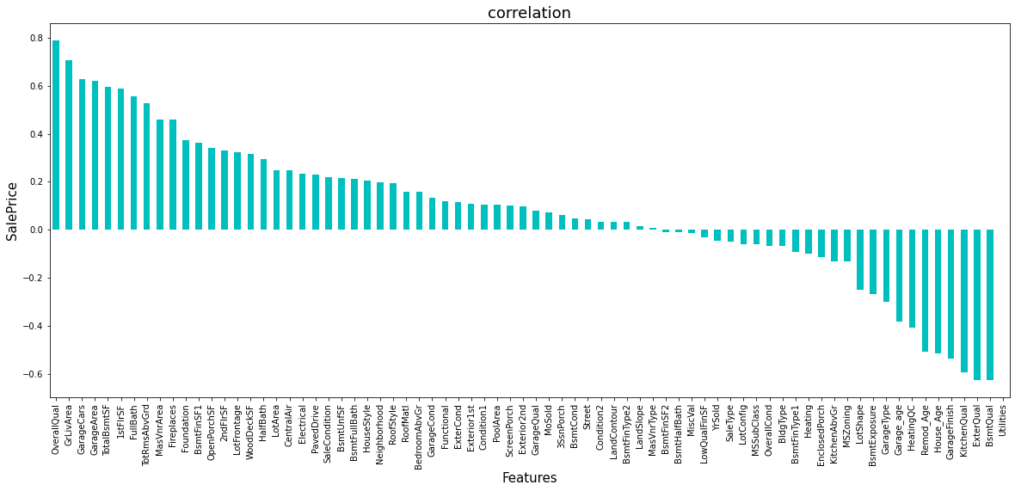
Finding Correlation of Feature columns with target column “Sales Price”

Slide 35
EDA Concluding Remarks:

Slide 36
OverallQual,GrLiveArea,GarageCars,GarageArea,TotalBsmtSF,1stFlrSF,FullBath,TotRmsAbvGrd,MasVnrArea,FirePlaces have the strongest positive correlation with SalePrice
BsmtQual,ExterQual,KitchenQual,GarageFinish,House_age,Remod_age,HeatingQC,Garage_age have the strongest negative correlation with SalePrice
Sales Price are Very much affected by many Factors.

Slide 37
Pre-Processing Remarks:

Slide 38
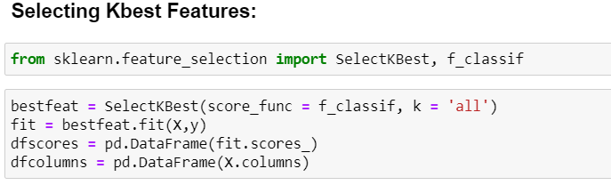
Features were first checked for presence of multicollinearity and then based on Principle Component Analysis and based on the respective ANOVA f-score values, the feature columns were selected that would best predict the Target variable, to train and test machine learning models.
Based on The Principle Component Analysis it was determined that 70 components explain around 95% variance in Data.
Best feature was selected to perform the operations.

Slide 39
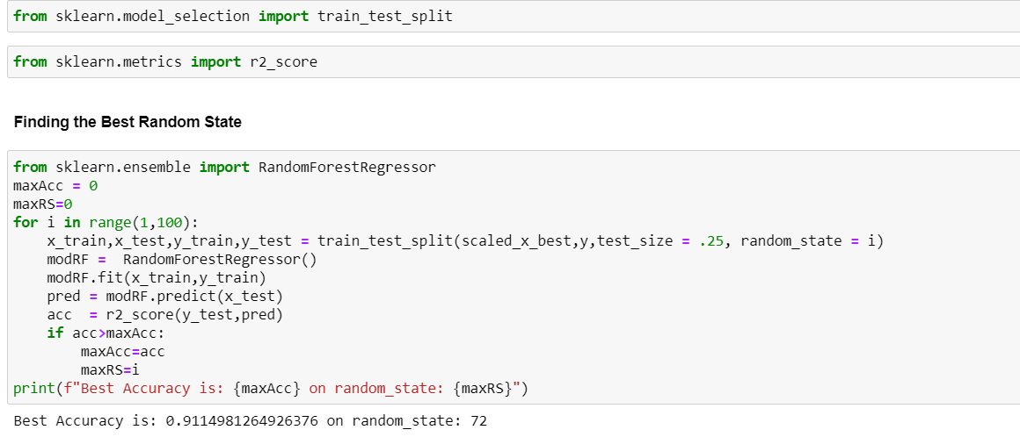
In order to find the best random state for the train and test split, the code used->
Best Accuracy is: 0.9114981264926376 on random_state: 72

Slide 40

Importing and training the required Libraries to Get the best Performing Model.

Slide 41
The model algorithms used
Ridge Regression: Ridge regression is a model tuning method that is used to analyse any data that suffers from multicollinearity. This method performs L2 regularization. Since the features have multicollinearity occurs, least-squares are unbiased, and variances are large, this results in predicted values to be far away from the actual values. Ridge shrinks the parameters. Therefore, it is used to prevent multicollinearity.
DecisionTreeRegressor: Decision Tree solves the problem of machine learning by transforming the data into a tree representation. Each internal node of the tree representation denotes an attribute and each leaf node denotes a class label.A decision tree does not require normalization of data. A decision tree does not require normalization of data.
XGBRegressor: XGBoost uses decision trees as base learners; combining many weak learners to make a strong learner. As a result it is referred to as an ensemble learning method since it uses the output of many models in the final prediction. It uses the power of parallel processing, supports regularization, and works well in small to medium dataset.
RandomForestRegressor: A random forest is a meta estimator that fits a number of classifying decision trees on various sub-samples of the dataset and uses averaging to improve the predictive accuracy and control over-fitting. A random forest produces good predictions that can be understood easily. It reduces overfitting and can handle large datasets efficiently. The random forest algorithm provides a higher level of accuracy in predicting outcomes over the decision tree algorithm.
Support Vector Regressor: SVR works on the principle of SVM with few minor differences. Given data points, it tries to find the curve. But since it is a regression algorithm instead of using the curve as a decision boundary it uses the curve to find the match between the vector and position of the curve. Support Vectors helps in determining the closest match between the data points and the function which is used to represent them. SVR is robust to the outliers. SVR performs lower computation compared to other regression techniques.

Slide 42
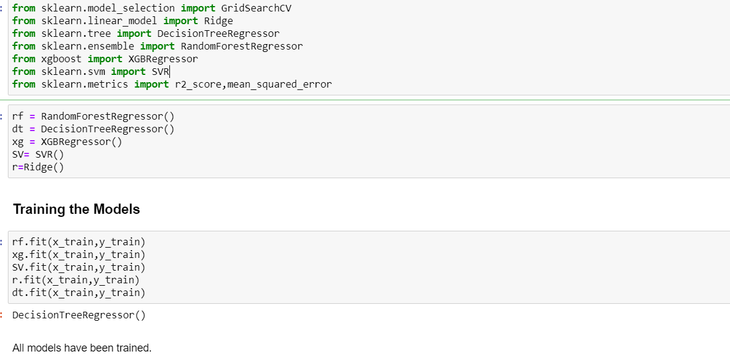

Slide 43
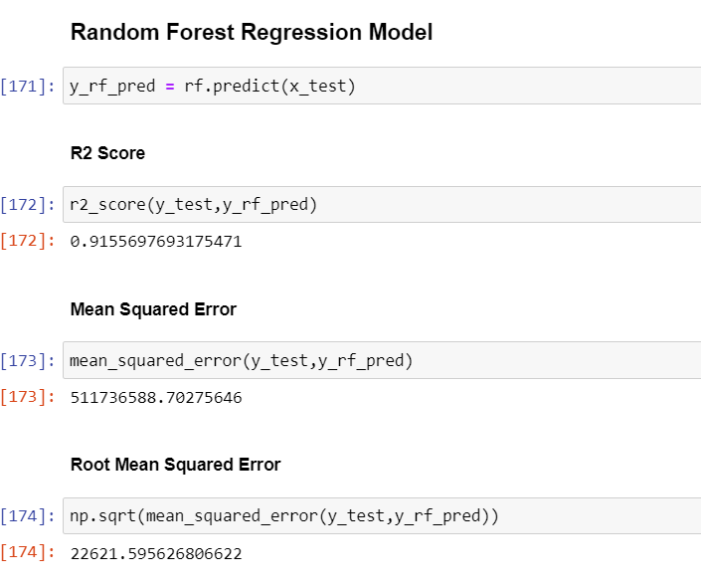
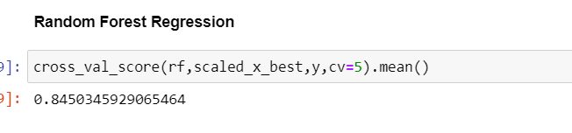
Based on Accuracy Score comparison results with Cross Validation results, it is determined that Random Forest Regressor is the best model. It also has the lowest Root Mean Squared Error score.

Slide 44
Interpretation of the Results
Hyper Parameter Tuning
GridSearchCV was used for Hyper Parameter Tuning of the Random Forest Regressor model.
Based on the input parameter values and after fitting the train datasets
The Random Forest Regressor model was further tuned based on the parameter values yielded from GridsearchCV.
The Random Forest Regressor model displayed an accuracy of 84.5%

Slide 45
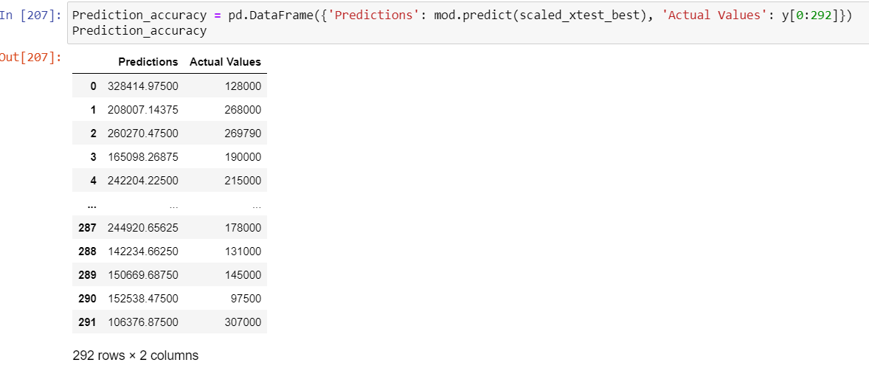
Interpretation of the Results
This model was then tested using a scaled Test Dataset comprising of 292 entries for 80 features. The model performed with good amount of accuracy.

Slide 46
Conclusion:
Based on the in-depth analysis of the Housing Project, The Exploratory analysis of the datasets, and the analysis of the Outputs of the models the following observations are made:
Structural attributes of the house Structural attributes of the house like lot size, lot shape, quality and condition of the house, garage capacity, rooms, Lot frontage, number of bedrooms, bathrooms, overall finishing of the house etc play a big role in influencing the house price.
Neighbourhood qualities can be included in deciding house price.
Various plots like Bar plots, Count plots and Line plots helped in visualizing the Feature-label relationships which corroborated the importance of structural and locational attributes for estimating Sale Prices.
Due to the Training dataset being very small, the outliers had to be retained for proper training of the models.
Therefore, Random Forest Regressor, being robust to outliers and being indifferent to non linear features, performed well despite having to work on small dataset.

Slide 47
Limitation & Future Scope:
While features that focus on structural and locational attributes of housing properties are crucial for estimating the Sale Price of Housing properties, they aren’t the only factors that influence the value in the housing market. Data on Demographics(Age, Income, Regional preferences of buyers, purpose of buying a property) is very important for understanding the Housing market. Interest Rates too impact the price and demand of houses. Economic cycles also influence Real Estate prices. Government Policies, Regulations, Legalizations are also important factors that may influence the sales of houses. The availability of data on above features would help build a predictive model that would more accurately understand the relationship between the features and target variable and yield more accurate predictions.

Slide 48




Thank you
Md Hafizur Rahman | Hifzurrahman_4u@yahoo.com | https://github.com/hafizur4u

